Slide 1
Tests of DMC-4183-D4140-D4140 Serial # 28206 Channel H
Test setup:
Step and direction lines connected to a digital data acquisition system, analogous to an oscilloscope but just measuring TTL level.
Acquisition rate = 1 kHz.
Motor moved 400 single steps in the positive direction. The direction line should not change state during the move.
TM1000
Changed KSH (1,2,4,8,16)
Conclusion:
Direction line changes state and there are extra pulses for KSH=1,2,4,8.
Direction line does not change start and there are the correct number of pulses for KSH=16.

Slide 2
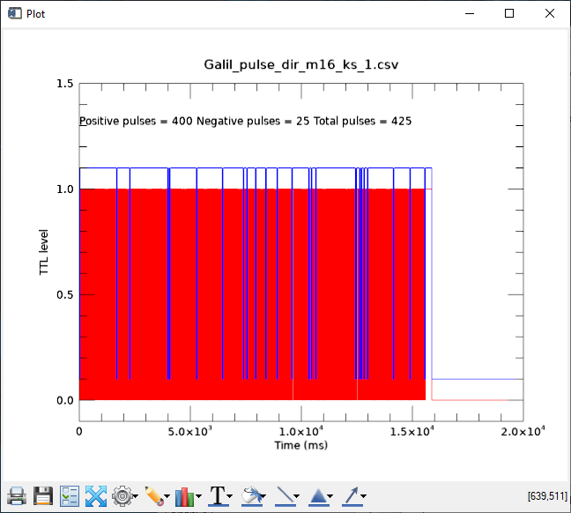
Serial # 28206 400 single steps, chan H, KS=1

Slide 3
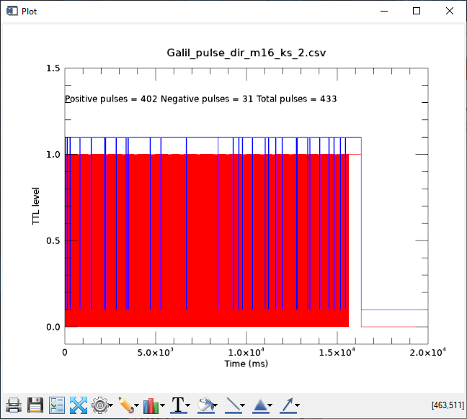
Serial # 28206 400 single steps, chan H, KS=2

Slide 4
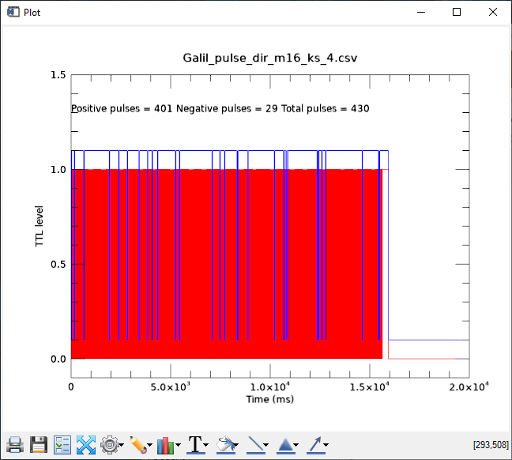
Serial # 28206 400 single steps, chan H, KS=4

Slide 5

Serial # 28206 400 single steps, chan H, KS=8

Slide 6
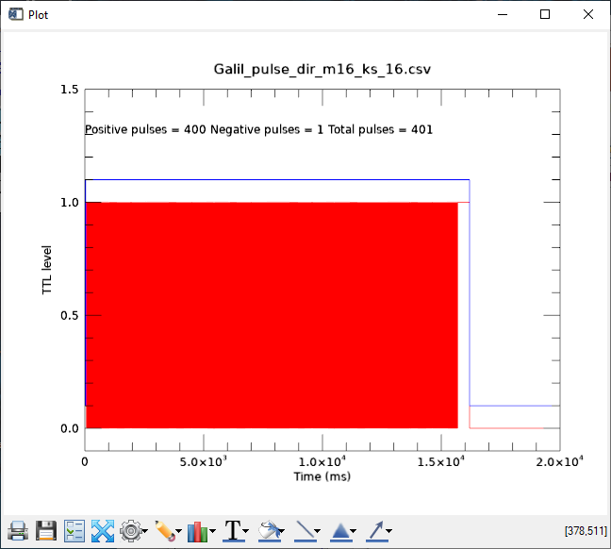
Serial # 28206 400 single steps, chan H, KS=16

Slide 7

Serial # 28206 400 single steps, chan A, KS=1

Slide 8
Tests of DMC-4183-D4140-D4140 Serial # 28206 Channel A
Test setup:
Same as for channel H above, changing KSA.
Conclusion:
No change in direction line or extra pulses for KSA=1,2,4,8,16
This channel behaves correctly.

Slide 9

Serial # 28206 400 single steps, chan A, KS=2

Slide 10

Serial # 28206 400 single steps, chan A, KS=4

Slide 11

Serial # 28206 400 single steps, chan A, KS=8

Slide 12

Serial # 28206 400 single steps, chan A, KS=16

Slide 13
Tests of DMC-4183-D4140-D4140 Serial # 28581 Channel H
Test setup:
Same as for serial number 28206 channel H above.
Conclusion:
No change in direction line or extra pulses for KSH=1,2,4,8,16
This controller behaves correctly on all channels, no problem with channel E-H.

Slide 14

Serial # 28581 400 single steps, chan H, KS=1

Slide 15
Tests of DMC-4183-D4140-D4140 Serial # 28206 Channel H
Test setup:
Step and direction lines connected to a digital data acquisition system, analogous to an oscilloscope but just measuring TTL level.
Acquisition rate = 1 kHz.
Motor moved with on 10-step move in the positive direction. The direction line should not change state during the move.
TM1000
KSH=1.313
Conclusion:
Direction line sometimes changes state and there are extra pulses for KSH=1,2,4,8.
Sometimes the correct pulse train is output.
Direction line does not change start and there are the correct number of pulses for KSH=16.
This proves that the issue is not just for single-step moves, it happens for multiple-step moves as well.

Slide 16
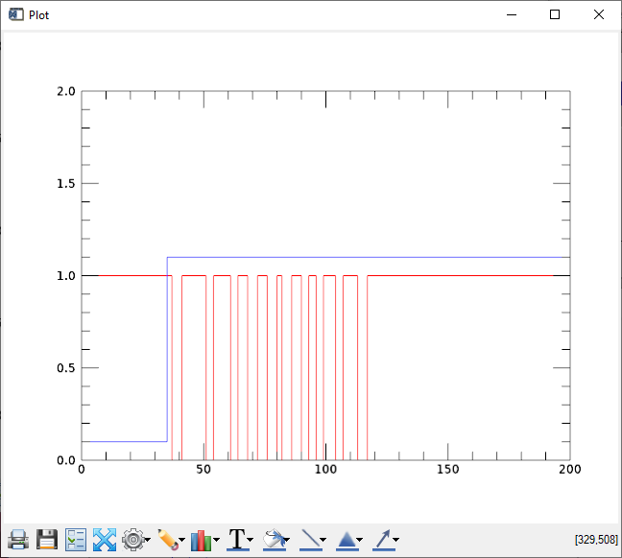
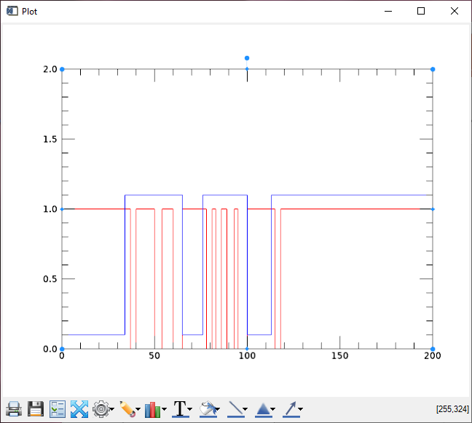
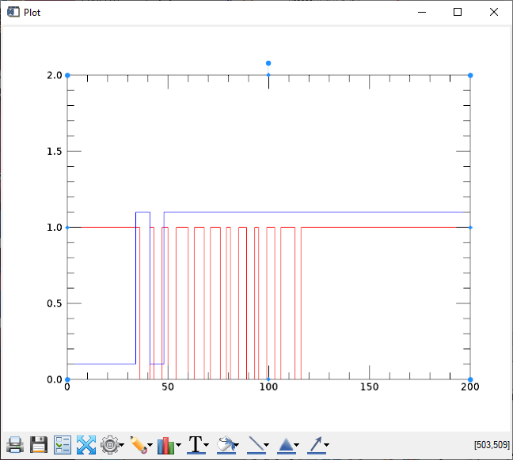
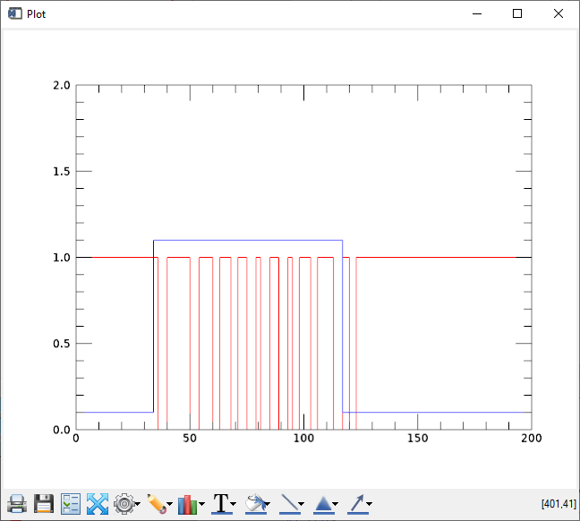
Channel H, KSH=1.313
This is what the trace should look like. It does this perhaps 80% of the time.
The other 3 traces are incorrect, the direction line is changing state and the motor is not told to move the correct number of steps.

Slide 17
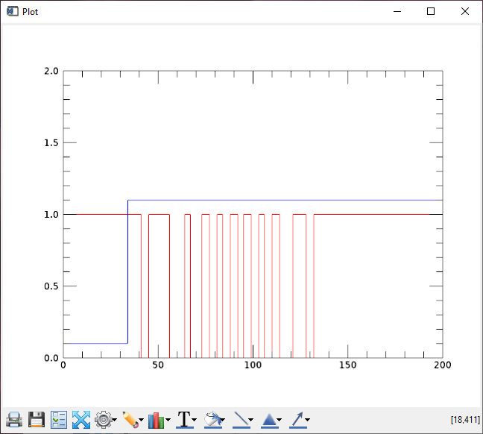
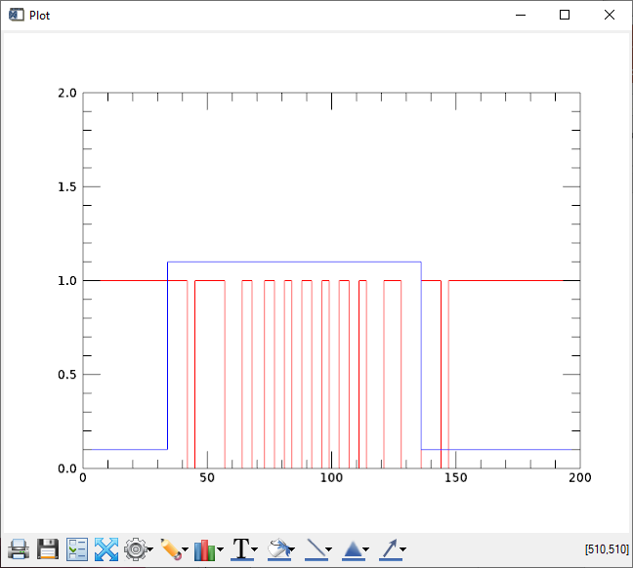
Channel H, KSH=4
Good trace
Bad trace

Slide 18
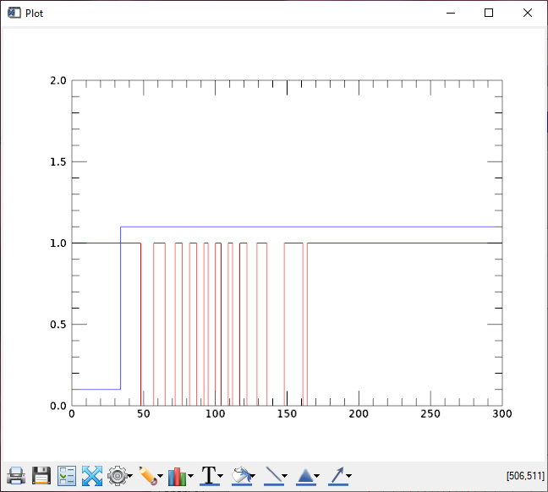
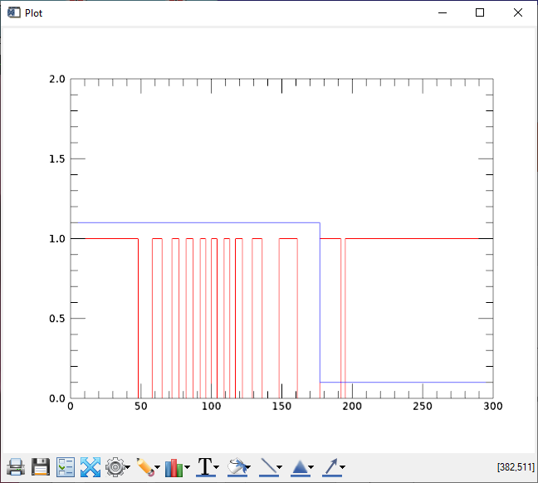
Channel H, KSH=8
Good trace
Bad trace

